Slide 1
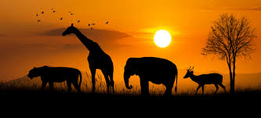
ANIMAL CLASSIFICATION
USING CNN
Team Guide:
D.Koteswarao Sir
Assistant Professor &HOD
Team Leader:
Ch.Someswari (21KP1A4422)
K.Roopchand (21KP1A4455)
K.Suresh (21KP1A4448)

Slide 2
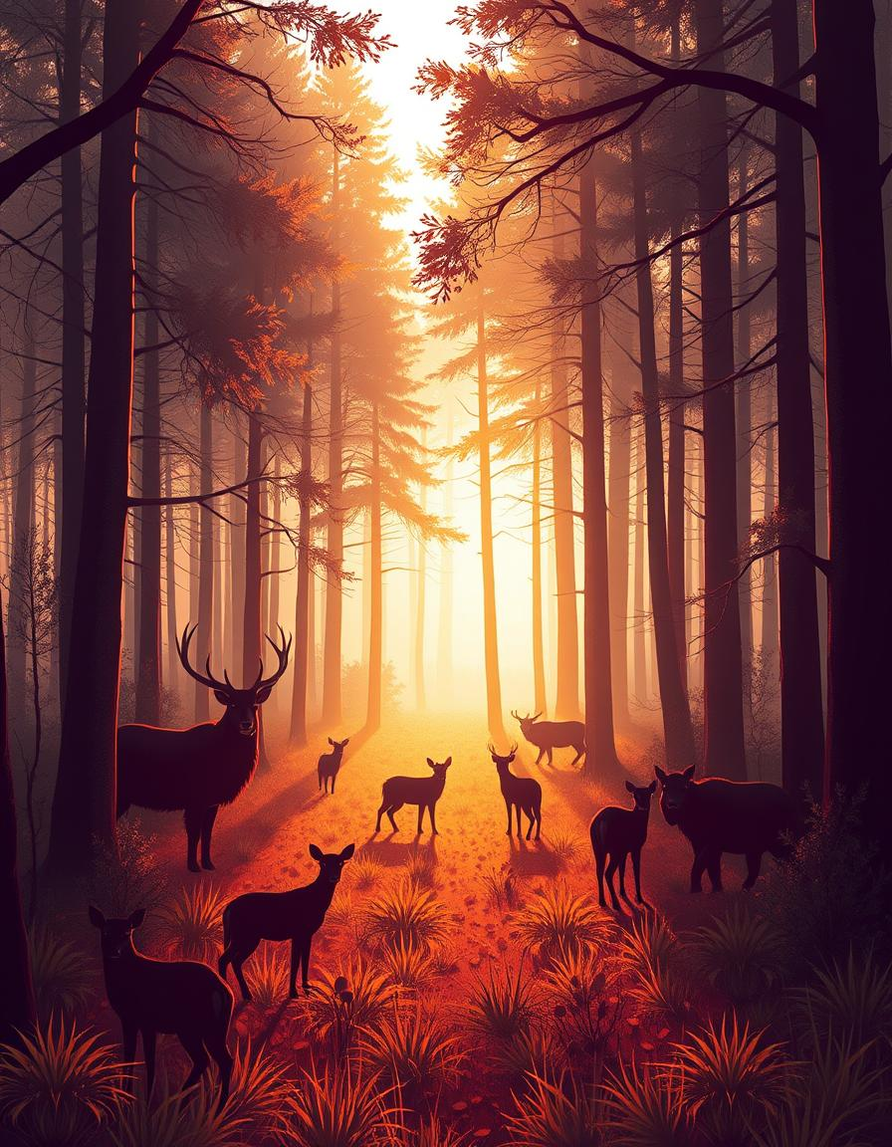
INTRODUCTION
Animal classification is a method of identifying and categorizing animals into respective classes.
It plays a vital role in ecological studies, wildlife monitoring, and biological research.
Supports wildlife monitoring and conservation by tracking animal populations and their habitats.
Useful in medical and agricultural research, where animal models help in disease studies and breeding programs.
Extremely time-consuming when dealing with large volumes of image data, especially from wildlife camera traps or drones.
Aim:To build a CNN-based model that can accurately classify various animals from images, making the classification process faster, scalable, and more reliable.

Slide 3

Project Abstract
Problem Statement
Current methods of animal classification are predominantly manual, demanding significant time and resources. These traditional approaches are also susceptible to human error and lack scalability for large datasets.
Proposed Solution
This project introduces a CNN-based solution designed to automate animal classification from images. This approach aims to enhance both accuracy and efficiency in identifying various animal species.
Objectives
The main objectives include building and training a CNN model to achieve high accuracy, developing a user-friendly interface for seamless image input and classification output, and rigorously evaluating the system's performance across a diverse dataset.
The expected outcome is a fully functional animal classification system capable of achieving a classification accuracy of 90% or higher on the test dataset, demonstrating a substantial improvement over existing methods.

Slide 4
Existing System & Proposed System
Existing System (Limitations)
Manual classification is slow and costly.
Traditional image processing lacks accuracy.
Poor scalability with large datasets.
Example: Animal Identification System (AIS) with 75% accuracy, limited to 50 species, and requires 5 minutes per image processing
Proposed System (Advantages)
Automated classification reduces time and cost.
CNNs offer high accuracy and robustness.
Scalable for handling extensive datasets.
Real-time classification capabilities.
Example: Improved AIS with CNN, targeting 95% accuracy, expanding the dataset to 200 species, and achieving a processing time of less than 1 second per image.
The proposed system aims to overcome the limitations of the existing methods by leveraging the power of CNNs to provide a more accurate, efficient, and scalable solution for animal classification.

Slide 5
Literature Review
S.NO | Author | Title | Description
1 | Dhruv Rathi, Sushant Jain, Dr. S. Indu, | Underwater Fish Species Classification using Convolutional Neural Network and Deep Learning” | . The accompanying advance uses Deep Learning approach by execution of Convolutional Neural Network for fish species characterization. Correlation of ReLU, Soft Max and tanh initiation capacities was performed and ReLU initiation work was viewed as profoundly precise
2 | Mohamad Aqib Haqmi Abas, Nurlaila Ismail, | VGG16 for plant image classification with transfer learning and data augmentation | Vgg 19 model is used for training plant images classification
3 | Hanguen Kim, Jungmo Koo, Donghoonkim | Image-Based Monitoring of Jellyfish Using Deep Learning Architecture | This letter presents preliminary results of applying an image-based jellyfish distribution recognition algorithm to increase the efficiency of an existing jellyfish removal system. By using a convolutional neural network and dedicated image processing techniques, the experimental results show reasonable performance for real-world application.

Slide 6
Literature Review
S.No | Author | Title | Description
4 | H. Yousif, J. Yuan, R. Kays | Fast human-animal detection from highly cluttered camera-trap images using joint background modeling and deep learning classification | This paper develops an effective background modeling and subtraction scheme to generate region proposals for the foreground objects and performs complexity-accuracy analysis of deep convolutional neural networks to develop a fast deep learning classification scheme
5 | Sayagavi, A.V., Sudarshan, T.S.B., Ravoor, | Deep Learning Methods for Animal Recognition and Tracking to Detect Intrusions. | The intrusion detection pipeline consists of three stages—animal detection, animal tracking and user alerts, and notifications. The proposed system is cost-effective and highly efficient, with an average accuracy of 98.8% in detecting and identifying animals in images.
6 | H. Nguyen et al | Animal Recognition and Identification with Deep Convolutional Neural Networks for Automated Wildlife Monitoring, | Deep learning algorithms are used for training and predicting animal images

Slide 7
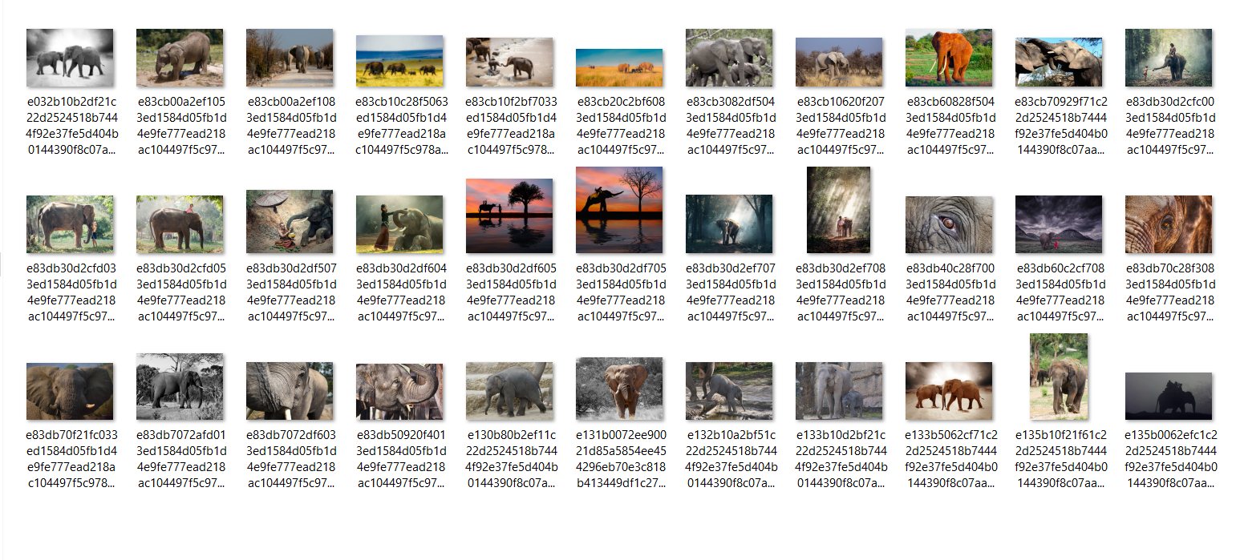
Data Collection
IN this project we use wound dataset collected from Kaggle which has 12 categories of animals . Pixel values form images are taken as input and labels are used as output and each folder has 50 images which are used for training. Video dataset of animals is also taken to train for prediction from videos.

Slide 8
Methodologies :
Dataset Collection
Collected a diverse animal image dataset from a reliable source (e.g., Kaggle).
Ensured variety in classes, backgrounds, and lighting conditions.
Preprocessing
Resized all images to 128x128 pixels.
Normalized pixel values and applied augmentation (rotation, zoom, flipping).
Labels encoded into one-hot vectors for multi-class classification.
Model Building (CNN Architecture)
Designed a custom CNN with multiple convolutional and pooling layers.
ReLU used as activation, and Softmax for the final classification layer.
Training and Validation
Trained using Adam optimizer and categorical crossentropy loss.
Used GPU to speed up training and avoid bottlenecks.
Monitored accuracy and loss over 25 epochs with batch size 32.
Evaluation & Results
Evaluated model performance using accuracy, loss curves, and a confusion matrix.
Validated predictions on test data and visualized results.
Prediction & Application
Deployed the model to predict animal classes from unseen images.
Demonstrated practical use cases in wildlife and educational domains.

Slide 9
SRS: Functional & Non-Functional
Requirements
Functional Requirements
Accept images in common formats (JPEG, PNG).
Resize, normalize, and augment images to prepare for CNN.
Load and execute the trained CNN model for classification.
Predict the animal class and provide a confidence score.
Display the predicted class and associated confidence score.
Provide an intuitive GUI for image upload and result display.
Non-Functional Requirements
Achieve >=90% classification accuracy on the test dataset.
Classify an image in less than 1 second.
Handle a large number of images efficiently.
User-friendly interface with minimal training.
99.9% uptime.
The system must meet these performance targets while remaining user-friendly and secure. Security requirements are detailed on the next slide.

Slide 10
SRS: Security Requirements &
Hardware/Software Requirements
Security Requirements
Role-based access control.
Data encryption (AES-256).
Secure authentication with strong password policies.
Input validation to prevent injection attacks.
Software Requirements
Python 3.8 or later.
Operating system : Windows XP/7/10
IDE :Anaconda prompt.
Flask framework.
PostgreSQL database.
Hardware Requirements
High-performance server with GPU (NVIDIA Tesla V100 with minimum 16GB VRAM), 64GB RAM, and 1TB SSD storage. Client-side: standard desktop or laptop with a web browser.
These measures ensure the system's reliability, data protection, and compliance with security best practices. Security is paramount to protect user data and system integrity.

Slide 11
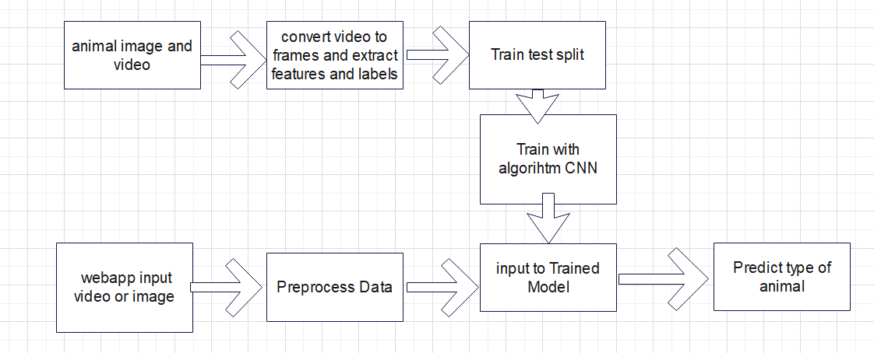
CNN ARCHITECTURE

Slide 12
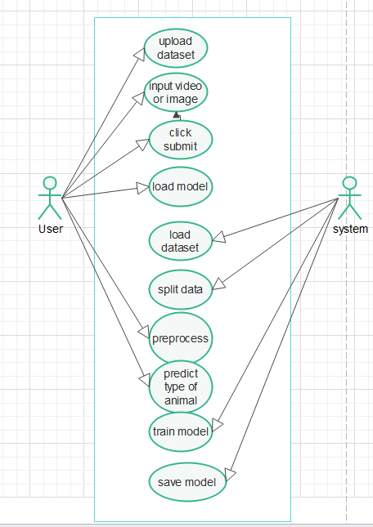
Use Case Diagram

Slide 13
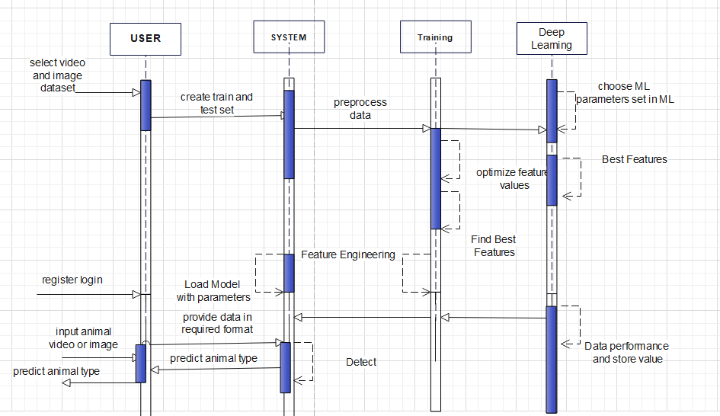
Sequence Diagram

Slide 14
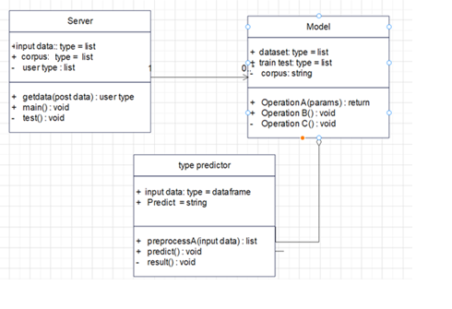
Class Diagram

Slide 15
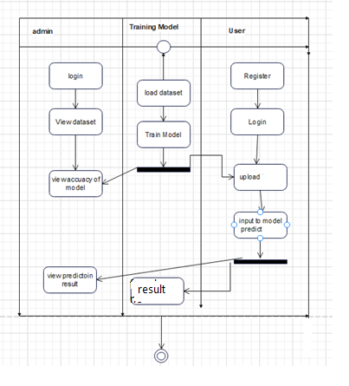
Activity Diagram

Slide 16
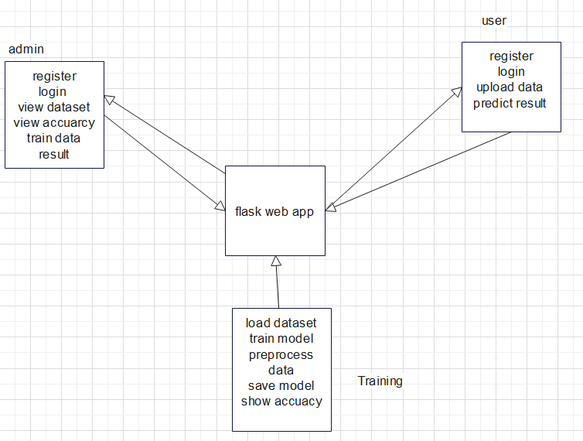
Data Flow Diagram

Slide 17
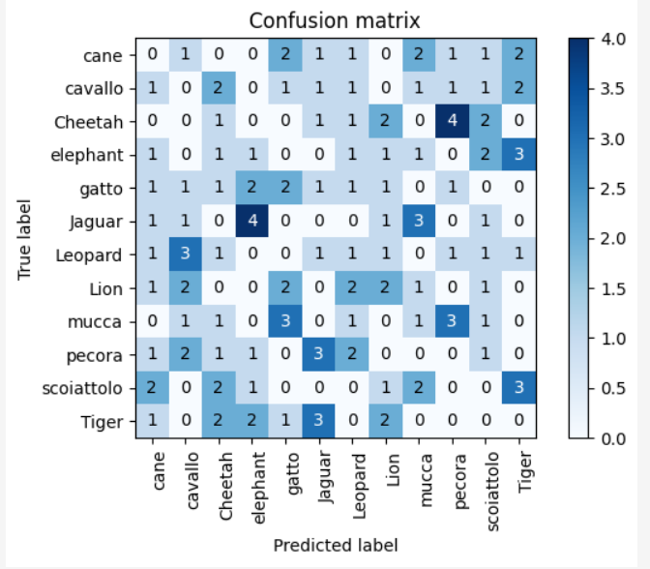
OUTPUT : The confusion matrix indicates high accuracy across most animal classes, showing minimal misclassifications.”

Slide 18
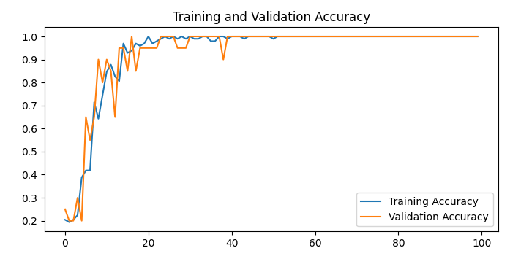
Model Performance :Training vs Validation Accuracy
The model achieves high accuracy on both training and validation sets,indicating good generalization and minimal overfitting

Slide 19
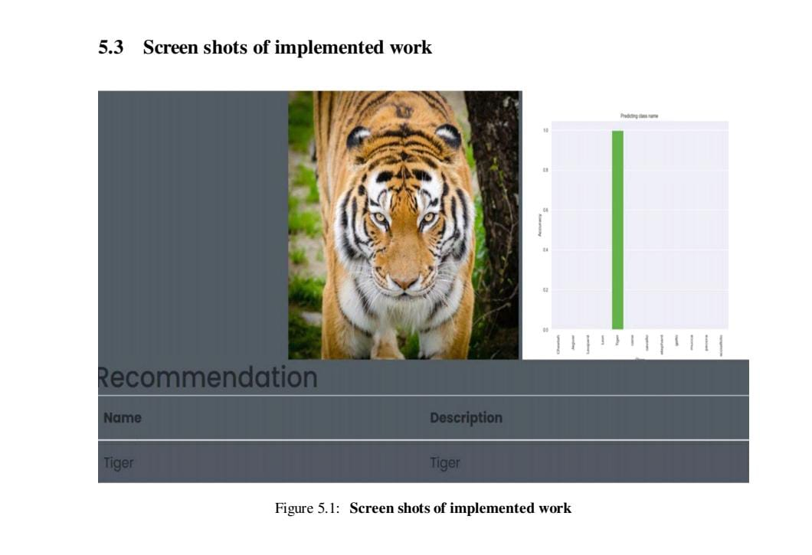

"The final model is integrated into a Flask web application for user-friendly image uploads and real-time predictions."

Slide 20
Future Scope :
In the future, this project can be extended to classify a wider range of animal species
including those found in different environments such as marine, desert, or forest ecosystems. By increasing the dataset size and diversity, the model can learn better and generalize well to unseen categories. Real-time animal recognition can also be integrated using live webcam feeds or mobile cameras, which would be highly useful in wildlife tracking and educational applications. Moreover, deploying this model as a mobile or web application will allow users to access it easily without needing technical knowledge.
To enhance the performance further, we can use transfer learning by applying powerful pre-trained models like ResNet or EfficientNet. These models are already trained on massive image datasets and can improve the accuracy of animal classification with less training time. In addition, adding explainability features such as Grad-CAM will help users understand which parts of the image influenced the model’s prediction. This increases transparency and trust in AI systems. Overall, the future scope is broad and promising, especially in fields like education, wildlife conservation, and mobile AI-based tools.

Slide 21
THANK YOU

